Slide 1



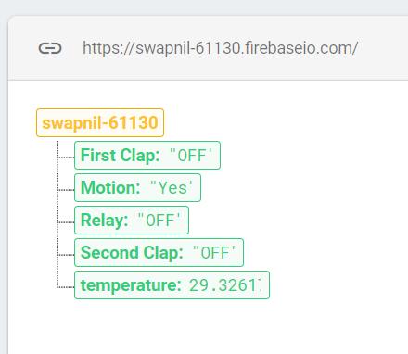
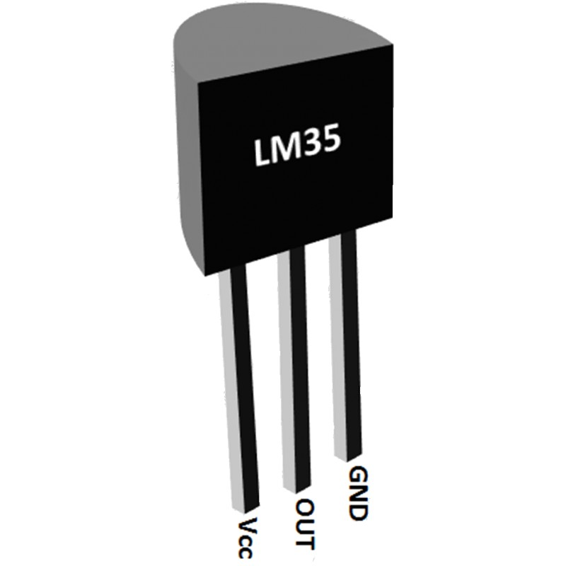
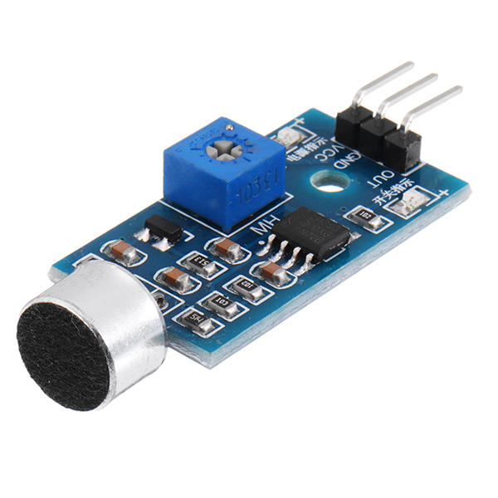
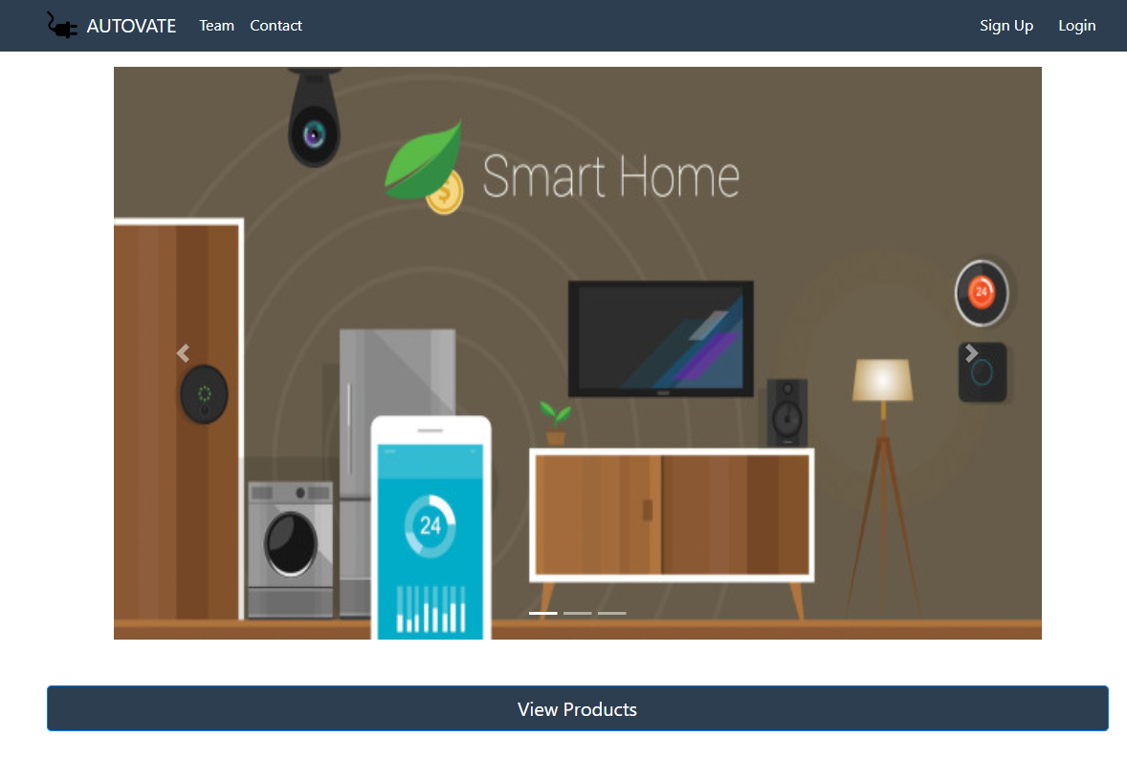
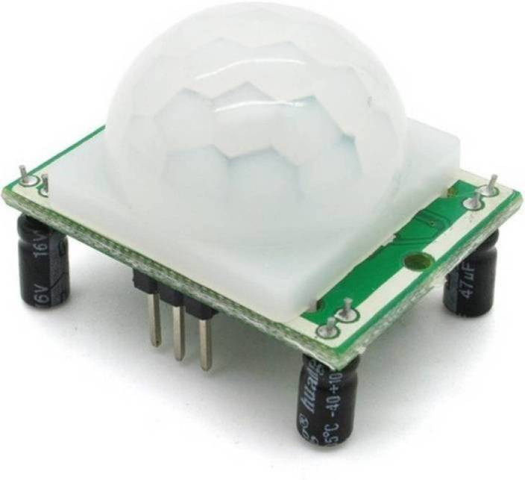
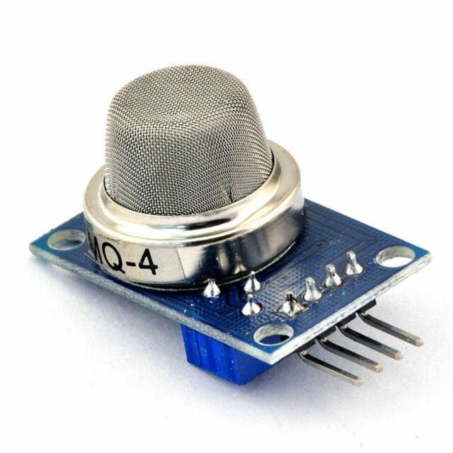
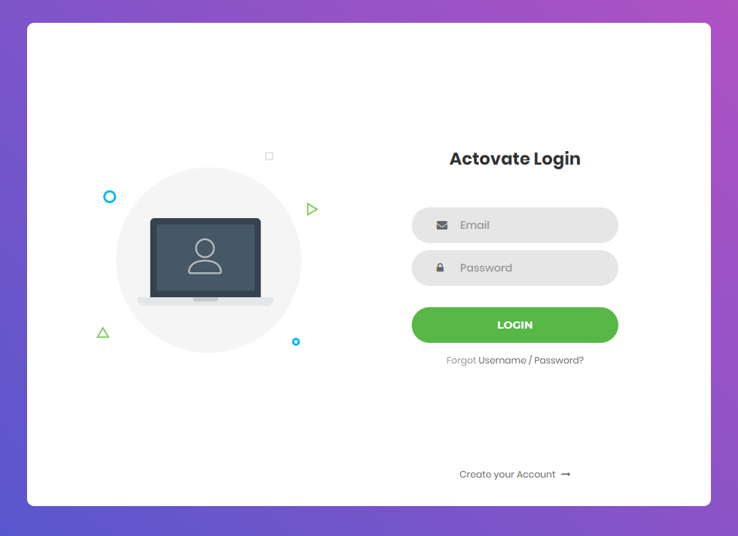
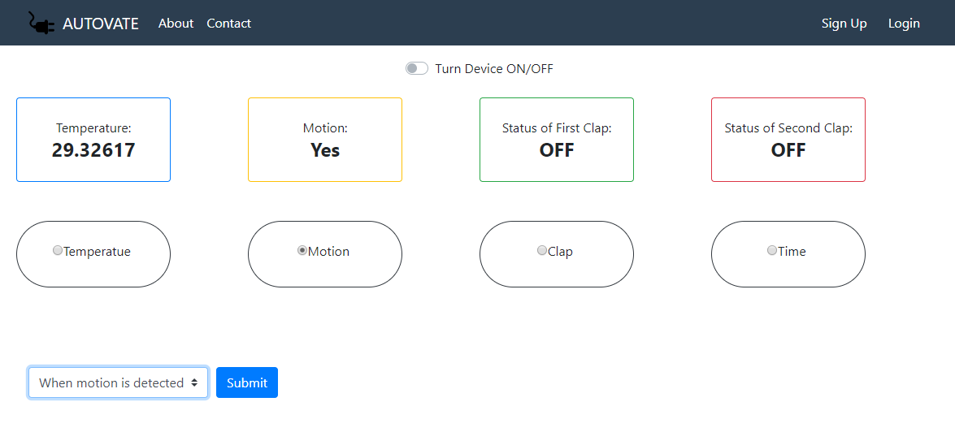












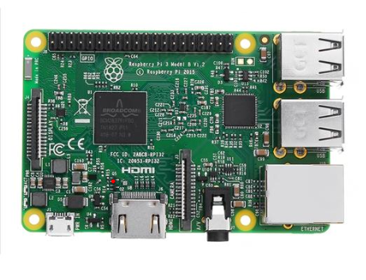

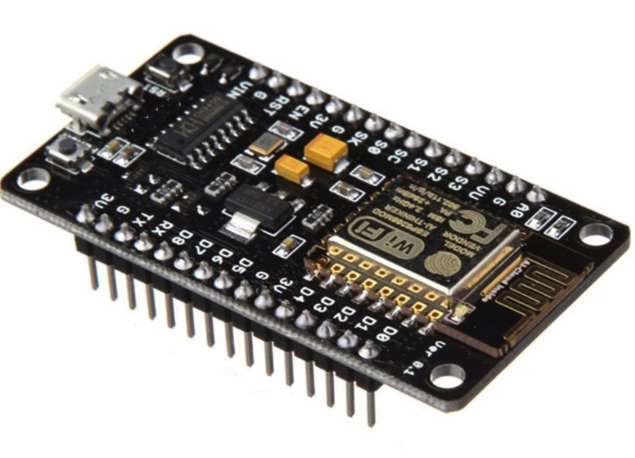
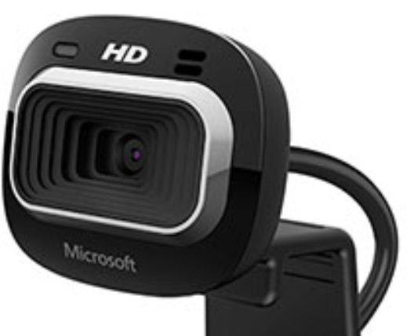
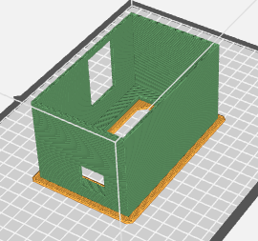

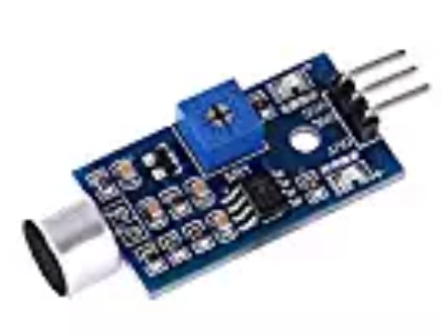
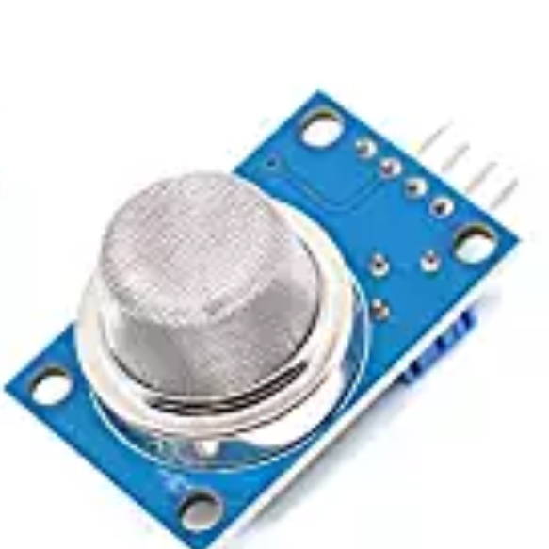
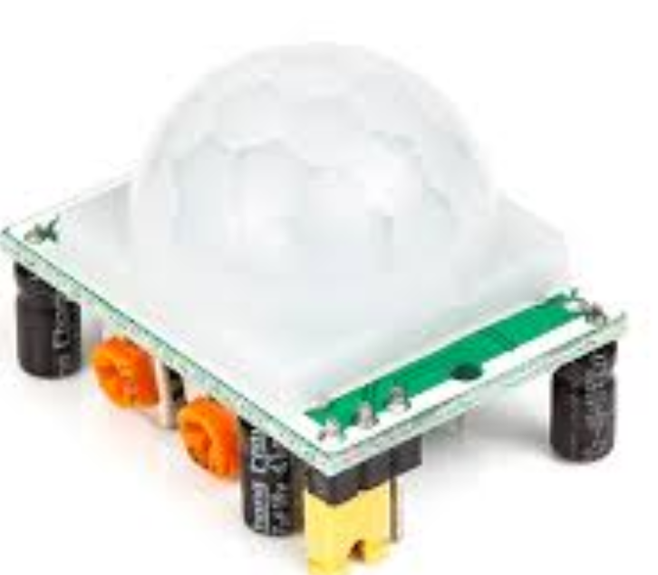
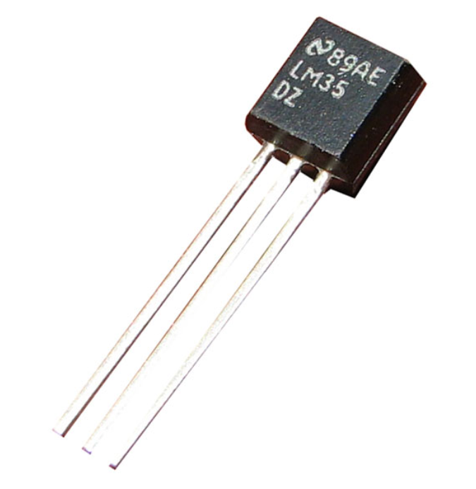

User Programmable Home Automation and Security System
Swapnil Modani
Advisors: David Arnold, Dr. Jafar Saniie
Department of Electrical and Computer Engineering
Embedded Computing and Signal Processing Research Laboratory
Abstract
User Interface
Realtime Database
Sensor Integration
With the world moving drastically into the field of automation, and towards smart devices; the existing technology becomes irrelevant. To make the old devices smart and control them effectively and efficiently we build the Autovate Home Security and Automation System.
Home automation is successfully achieved by:
Allowing to turn any device ON/OFF from anywhere in the world
See the live sensor(temperature, motion, smoke, sound) from the real-time website
Self program the website to control any device based on the sensor parameters
View the live video of the environment real-time on a webpage
Motion Capture and Detection that sends an email with the recorded pictures and save videos offline
The user interface allows the user to interract with our back-end hardware in order to control devices plugged into our setup. It has been made to adapt dynamically to changes and platforms.
Firebase is a Backend-as-a-Service platform on Google Cloud Platform. The Firebase Realtime Database is a cloud-hosted database that lets you store and sync data between the users in real-time.
Temperature sensor gives an analog output (voltage between 0-3.3V) i.e. converted using a 10bit ADC.
The sound sensor in our case is programmed to identify single and double clap.
The home page for our user interface that allows access to the sign-up, login, team page and the control panel
The motion sensor is a digital transducer that sends a high pulse whenever motion is detected.
The Firebase Console as shown in the figure took in data from the sensors and updated real-time.
This data is pulled by the website using authenticated AES-256 bit encryption
The real-time database also allows us to store information, datasets, pictures with ML kits, etc.
The smoke sensor detects smoke level in the air and a threshold can be set that trigger an alarm.
This is in the Login page that uses Bootstrap architecture to improve user interface platform.
Conclusion
Programming
The research successfully implements better, more advanced alternatives to existing technology that allows the user to control his/her home more efficiently. This setup allows users to make their home smarter without changing existing devices making it economical for commercial usage.
Control panel, where the user has access to view complete data and program according to the sensor values
Delta Threshold
HTML5, JavaScript, CSS3, jQuery and Bootstrap architecture has been used to make this website come to life
The Sensor Integration to the Cloud Real-time Database is done using C++
The image processing to detect motion uses OpenCV (computer vision) on python platform.
The videostream from the raspberry pi to the webpage uses threading on python platform.
Frame Delta
Objectives
Delta Threshold
Future Work
Use advanced low power microcontroller ESP8266 NodeMCU to collect data
Demonstration
Since there is so much data collected from the sensors, we can apply machine learning algorithms to predict better. An app along with the website can be added to improve user interface.
Prepossessing data before sending it to Google Firebase (Real-time Database)
User device
(Autovate website)
Cloud computation to post process the data for multi-platform access
3D Model Design
References
IoT: An Application Based Approach Using Arduino Platform and Firebase by Saurav Kumar
https://firebase.google.com/docs (Firebse Documentation)
https://github.com/FirebaseExtended/firebase-arduino (library for firebase )
Pulling the data from the cloud and displaying it on the website
The 3D model was designed on Autodesk Inventor. There were slots made for the sensors (Sound Sensor), plug for any device and top and bottom are acrylic laser cut sheets so that a user can see the hardware components and connections. The model was printed using a Makerbot Replicator+.
Giving access to the user to change the status of the plug based on temperature, sound, smoke, time and motion data
Acknoledgement
Make a 3D printed model to house the electronics, components along with the PCBs
Thanks to my teammates, David Arnold, Dr Sannie, Dr Won Jae and all the members of ECASP laboratory for their contributions. BITMAA and BIT Mesra for their continuous support.
Sound Sensor
Smoke and gas
PIR sensor
Temperature Sensor

